Slide 1
MongoDB and .NET Aspire
Luce Carter | She/Her – Developer Advocate, MongoDB

Slide 2
Agenda
01
02
03
What is MongoDB?
Why MongoDB?
What about CosmosDB?
04
05
MongoDB with .NET Aspire
Useful Resources
@LuceCarter1​

Slide 3
What is MongoDB?
@LuceCarter1​

Slide 4
Document Database
Similar to Key-Value Database but supports more data types
Stores information in documents rather than rows and columns
General Purpose
Flexible Schema
Supports horizontal scaling
@LuceCarter1​

Slide 5






MongoDB
Database
Atlas Device SDKS
Charts
Analytics
Search
@LuceCarter1​

Slide 6
Why MongoDB?
@LuceCarter1​

Slide 7
MongoDB and Document Databases make life easier..
Availability
Flexibility
Scalability - Vertical
Scalability - Horizontal
Readability
@LuceCarter1​

Slide 8
MongoDB and Document Databases make life easier..
Availability
Flexibility
Scalability - Vertical
Scalability - Horizontal
Readability
Build better apps faster
@LuceCarter1​

Slide 9
MongoDB Atlas
@LuceCarter1​

Slide 10
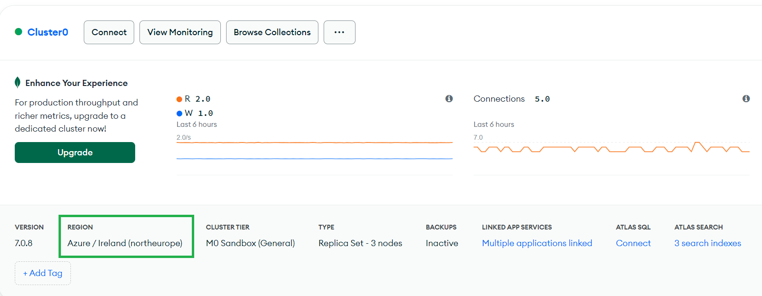
@LuceCarter1​

Slide 11
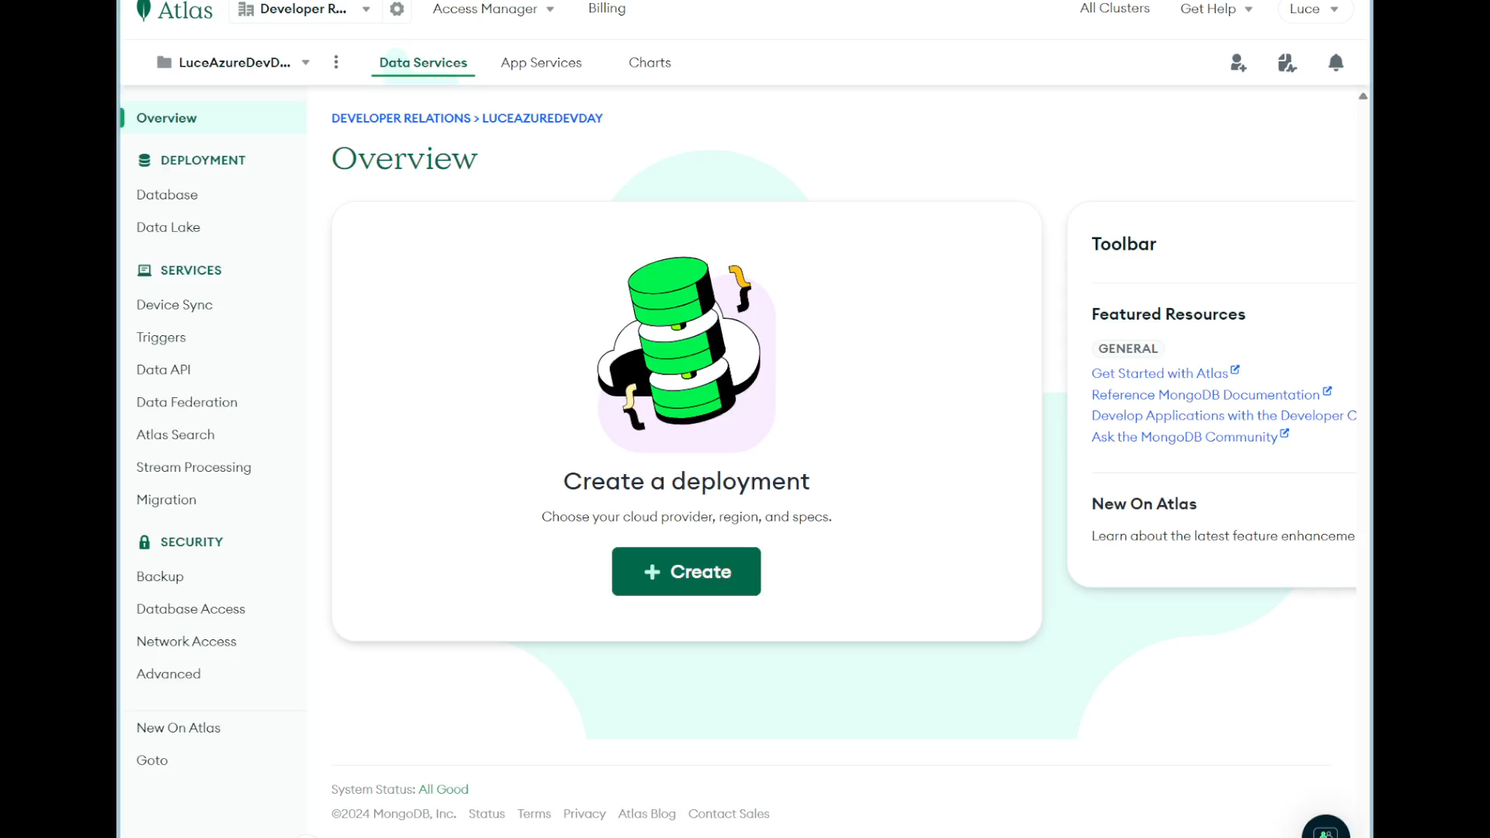
@LuceCarter1​

Slide 12
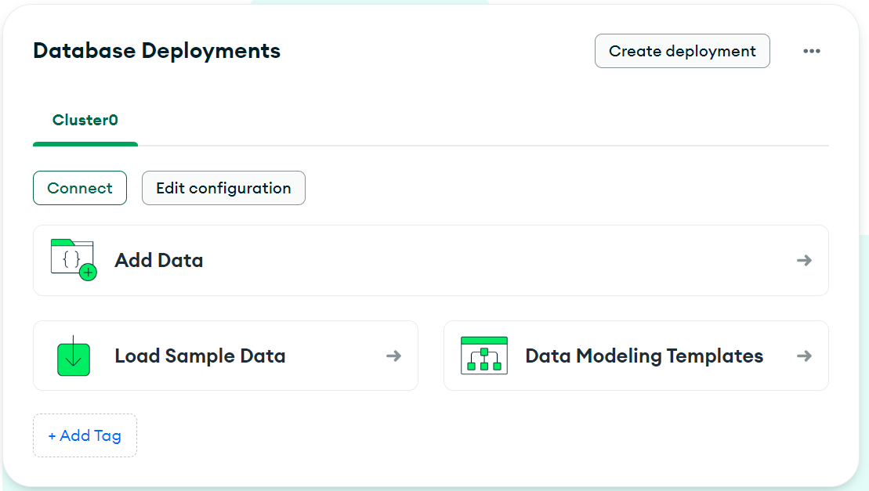
@LuceCarter1​

Slide 13
What about CosmosDB?
@LuceCarter1​

Slide 14

Use your Azure Credits while getting the advantages of Atlas
@LuceCarter1​

Slide 15
MongoDB and .NET Aspire
@LuceCarter1​

Slide 16
Does MongoDB work with .NET Aspire?
In short….yes 🎉
@LuceCarter1​

Slide 17
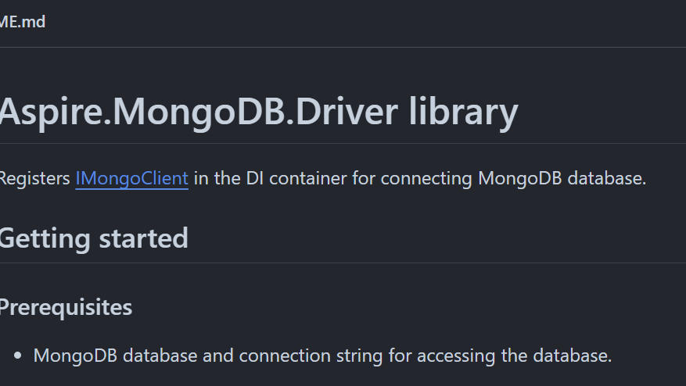
@LuceCarter1​

Slide 18
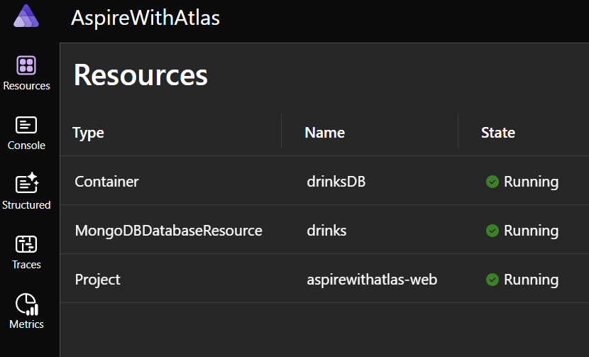
@LuceCarter1​

Slide 19
Demo Time
@LuceCarter1​

Slide 20
What about Entity Framework?
@LuceCarter1​

Slide 21
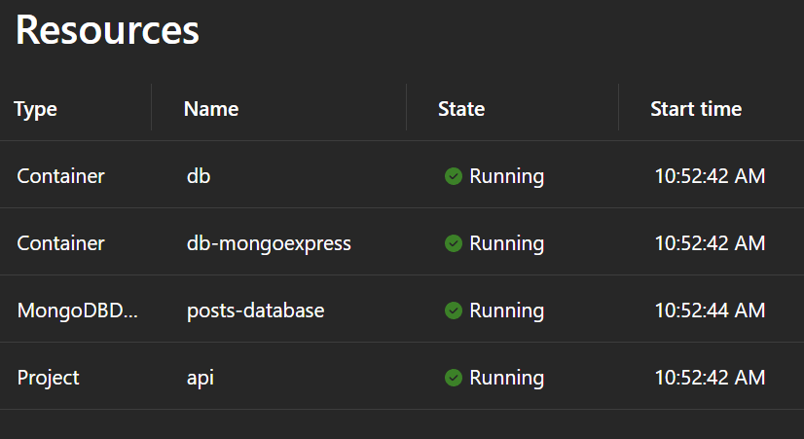
@LuceCarter1​

Slide 22
Demo Time
@LuceCarter1​

Slide 23
What else can you do?
@LuceCarter1​

Slide 24


Slide 25
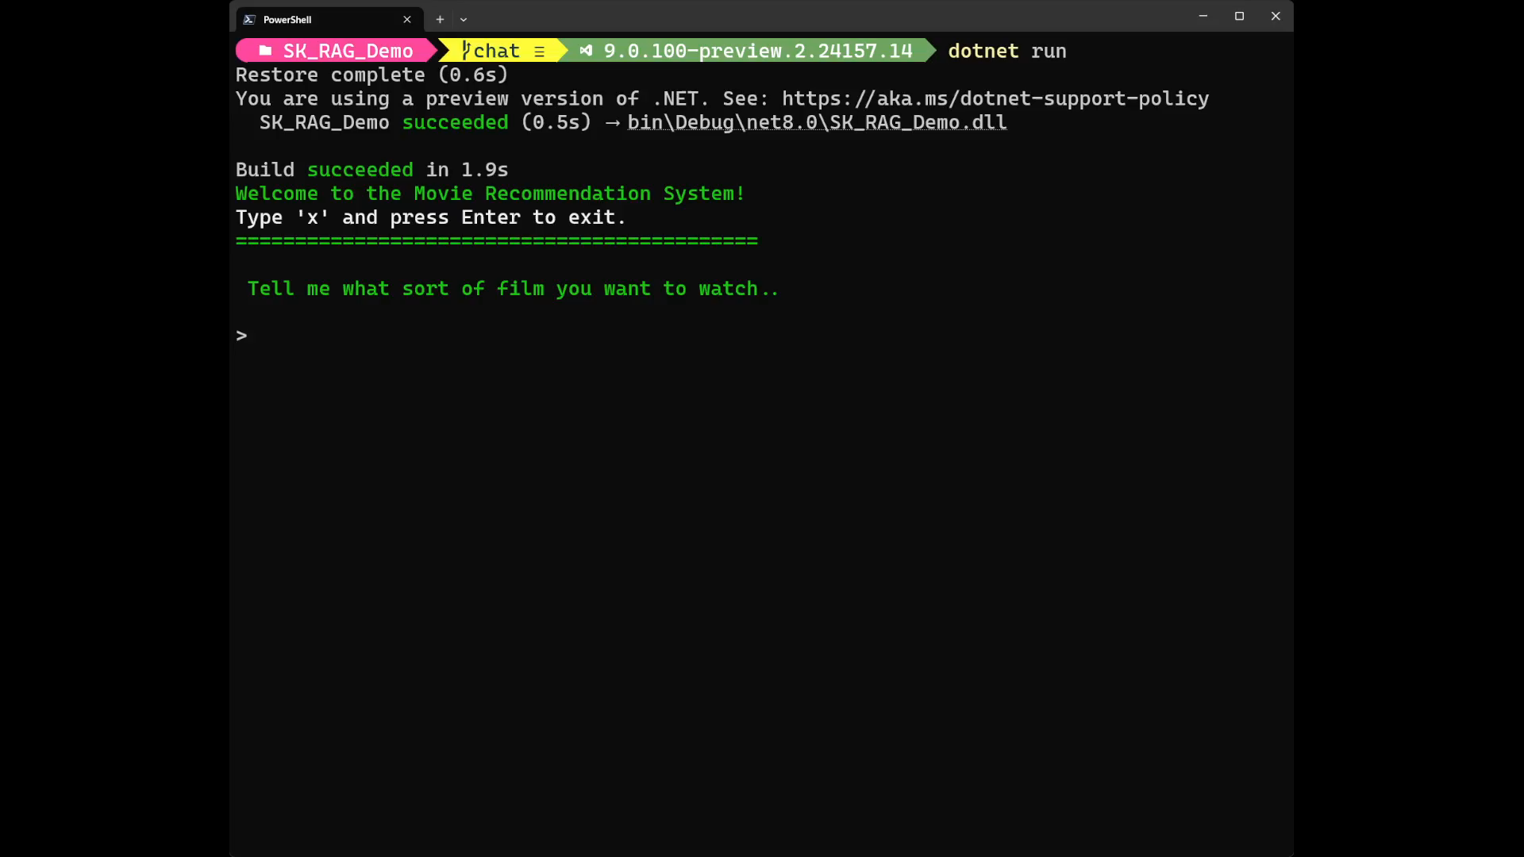
@LuceCarter1​

Slide 26
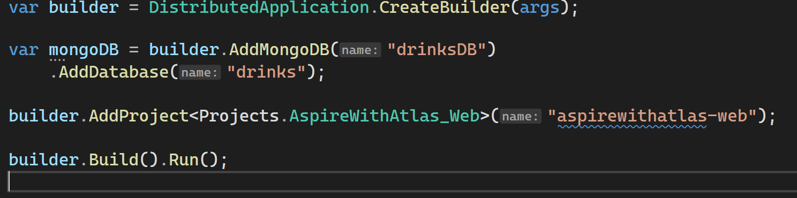
AppHost/Program.cs

Slide 27
Client Project/Program.cs

Slide 28
Summary
MongoDB and .NET Aspire are great friends!
You can use MongoDB Atlas and enjoy all the benefits available from the world’s first developer data platform
You can combine .NET Aspire with the new EF Core Provider to use a technology you may already know
You can expand on that even more with
@LuceCarter1​

Slide 29
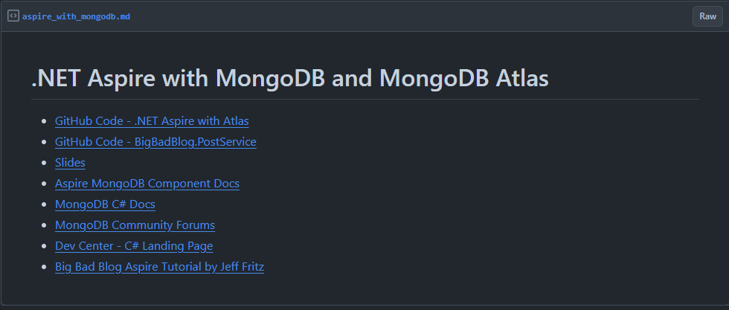
Useful Resources
@LuceCarter1​

Slide 30

Thanks!
https://mdb.link/dotnetaspire-with-mongodb
@LuceCarter1​

Slide 31
.NET Aspire Developers Day
Start your learning journey:
aka.ms/dotnetAspireDevDay/Collection

